Slide 1
Thomas Algorithm Solving Sparse Matrices
By Christopher Gonzalez-millan, Aaron Schwan

Slide 2
Outline
FEA –Strong Gerlakin Example Problem
Numerical Solution converging plot
Thomas Algorithm overview
Speed ups for alpha and beta
Differences CPU vs GPU
Time required vs implementation
Memory vs implementation
Ending – more sparse matrix uses

Slide 3
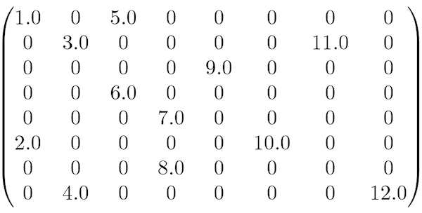
Sparse Matrices
A matrix A is called sparse if the number of zero entries significantly out number of non-zero entries
Uses:
cubic splines
FEM differential equations
graph theory
image processing
Example:

Slide 4
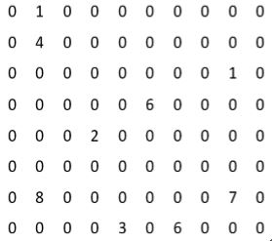
Sparse Matrices Issues
they still occupy memory for zero elements
even though we know the result is zero, computational time is still needed to perform calculations.
Example:

Slide 5
1-D Finite Element Method Analysis

Slide 6
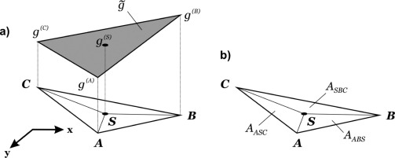
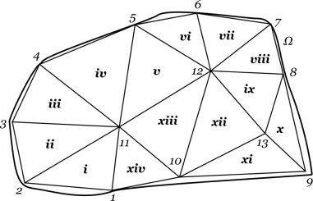
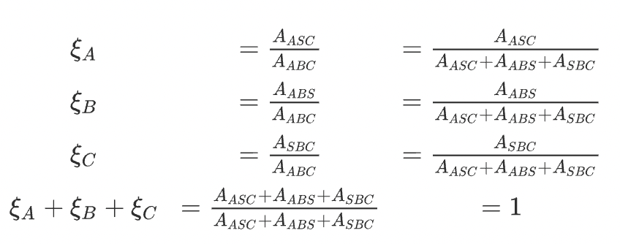
Problem Setup
Discretization
Sub-Domain:
Lagrangian Coordinates:

Slide 7
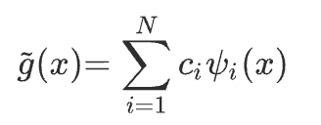
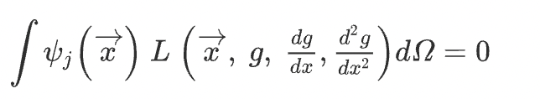
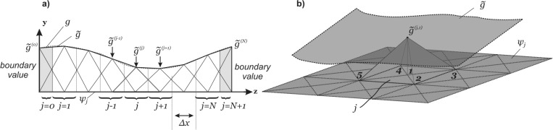
Galerkin Method Approximations
Formulation:

Slide 8
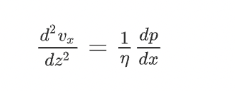
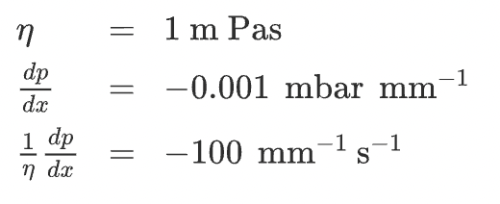
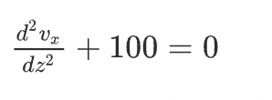

Flow in Infinitesimally Extended Channels
Poiseuille flow in planar, infinitesimally extended channels

Slide 9
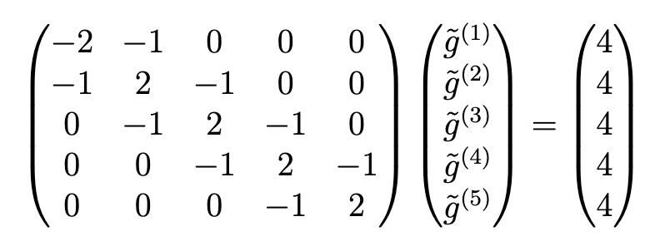

Slide 10
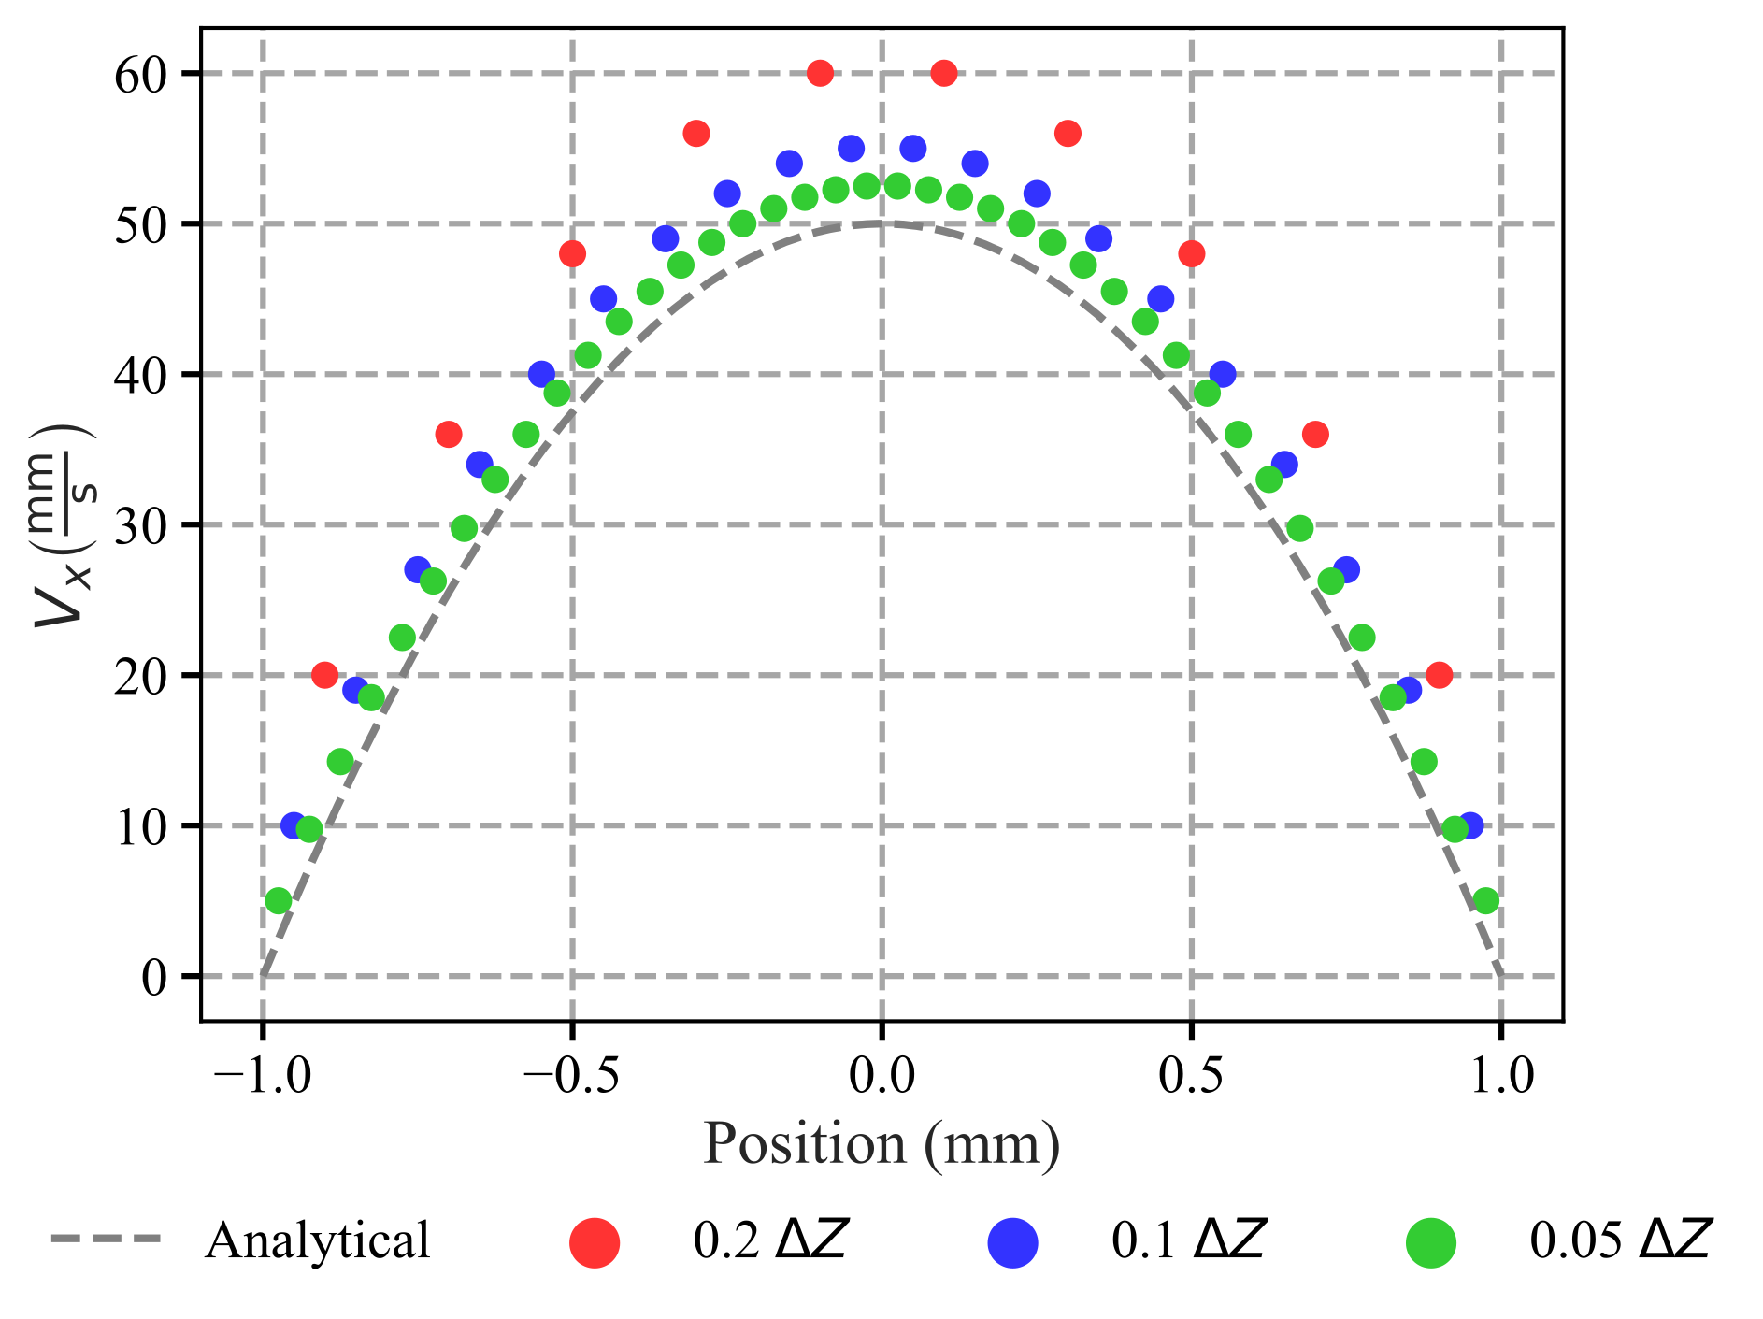
Numerical Solution

Slide 11
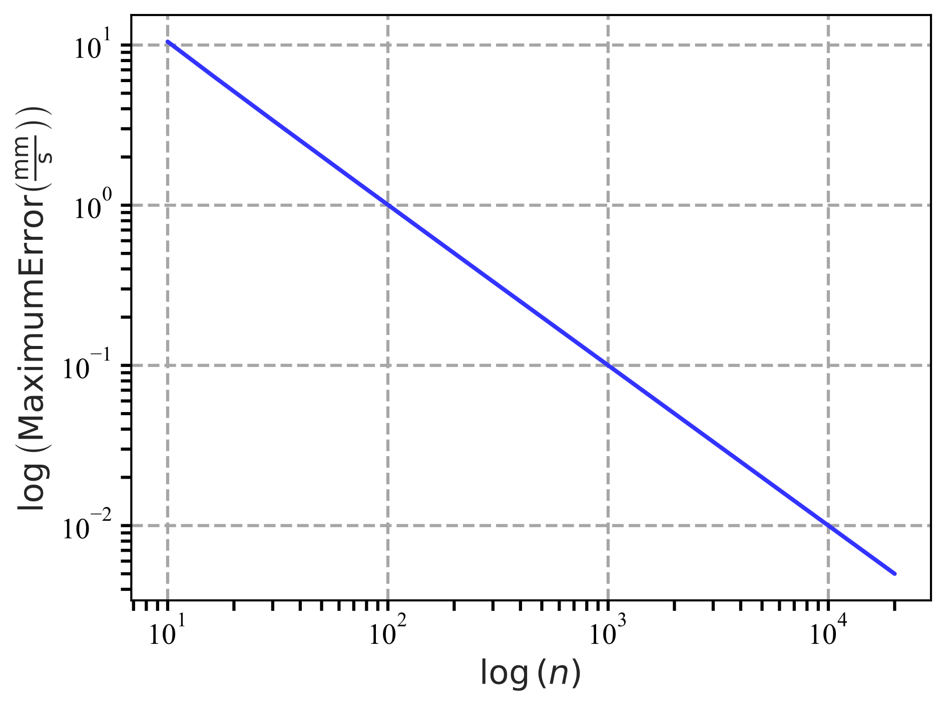
Error Reduction

Slide 12
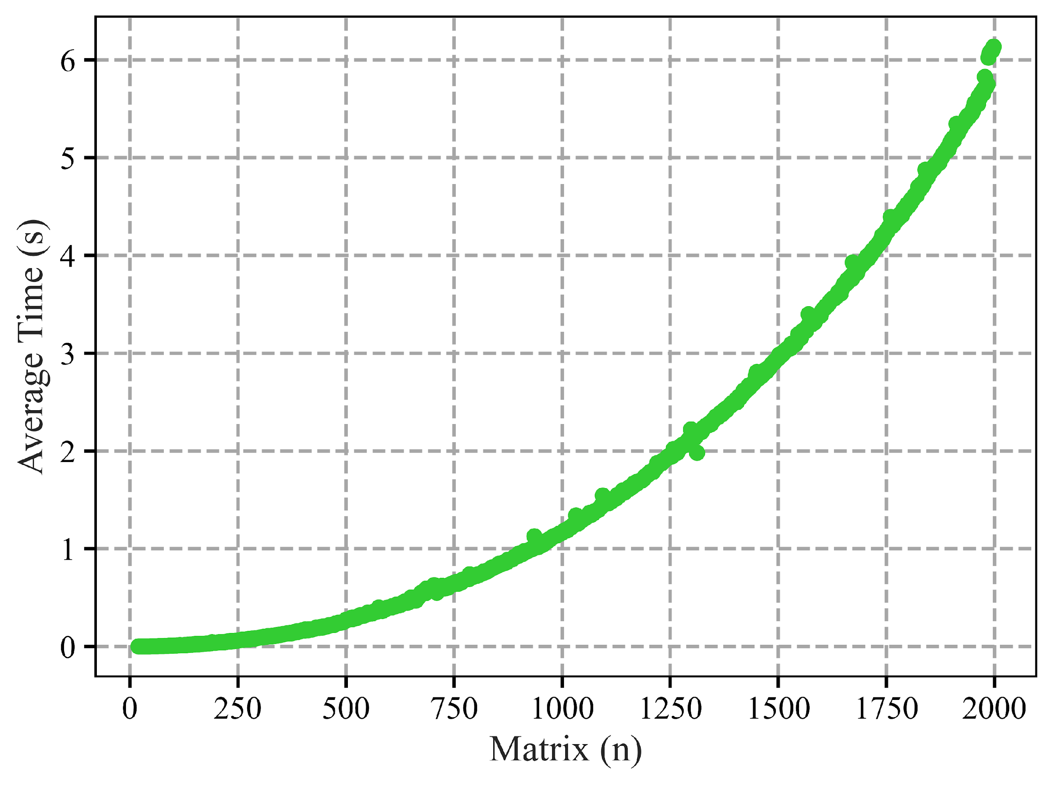
Gaussian Row Elimination

Slide 13

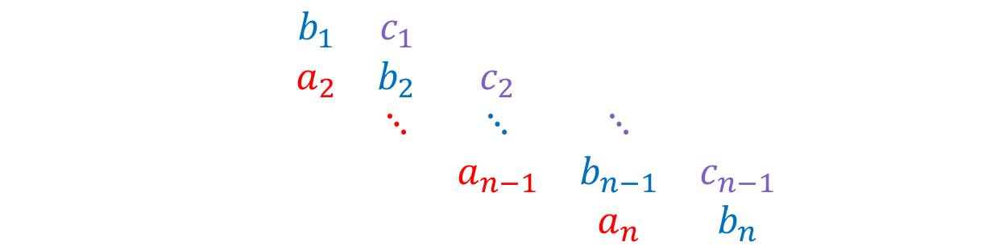
Thomas Algorithm

Slide 14
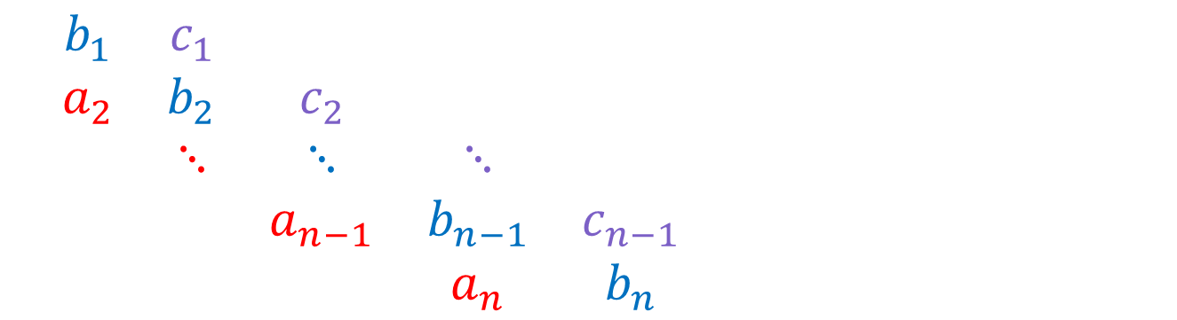



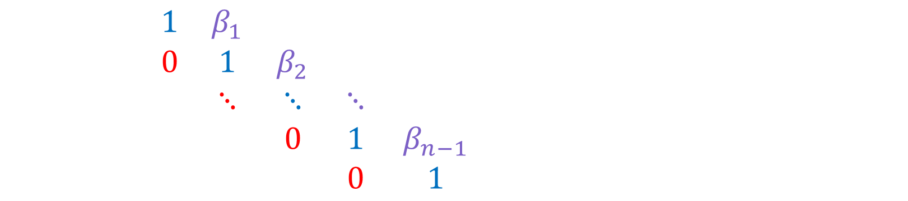

Thomas Algorithm Continued
Forward Substitution
Backward Substitution

Slide 15





Speeding Up

Slide 16
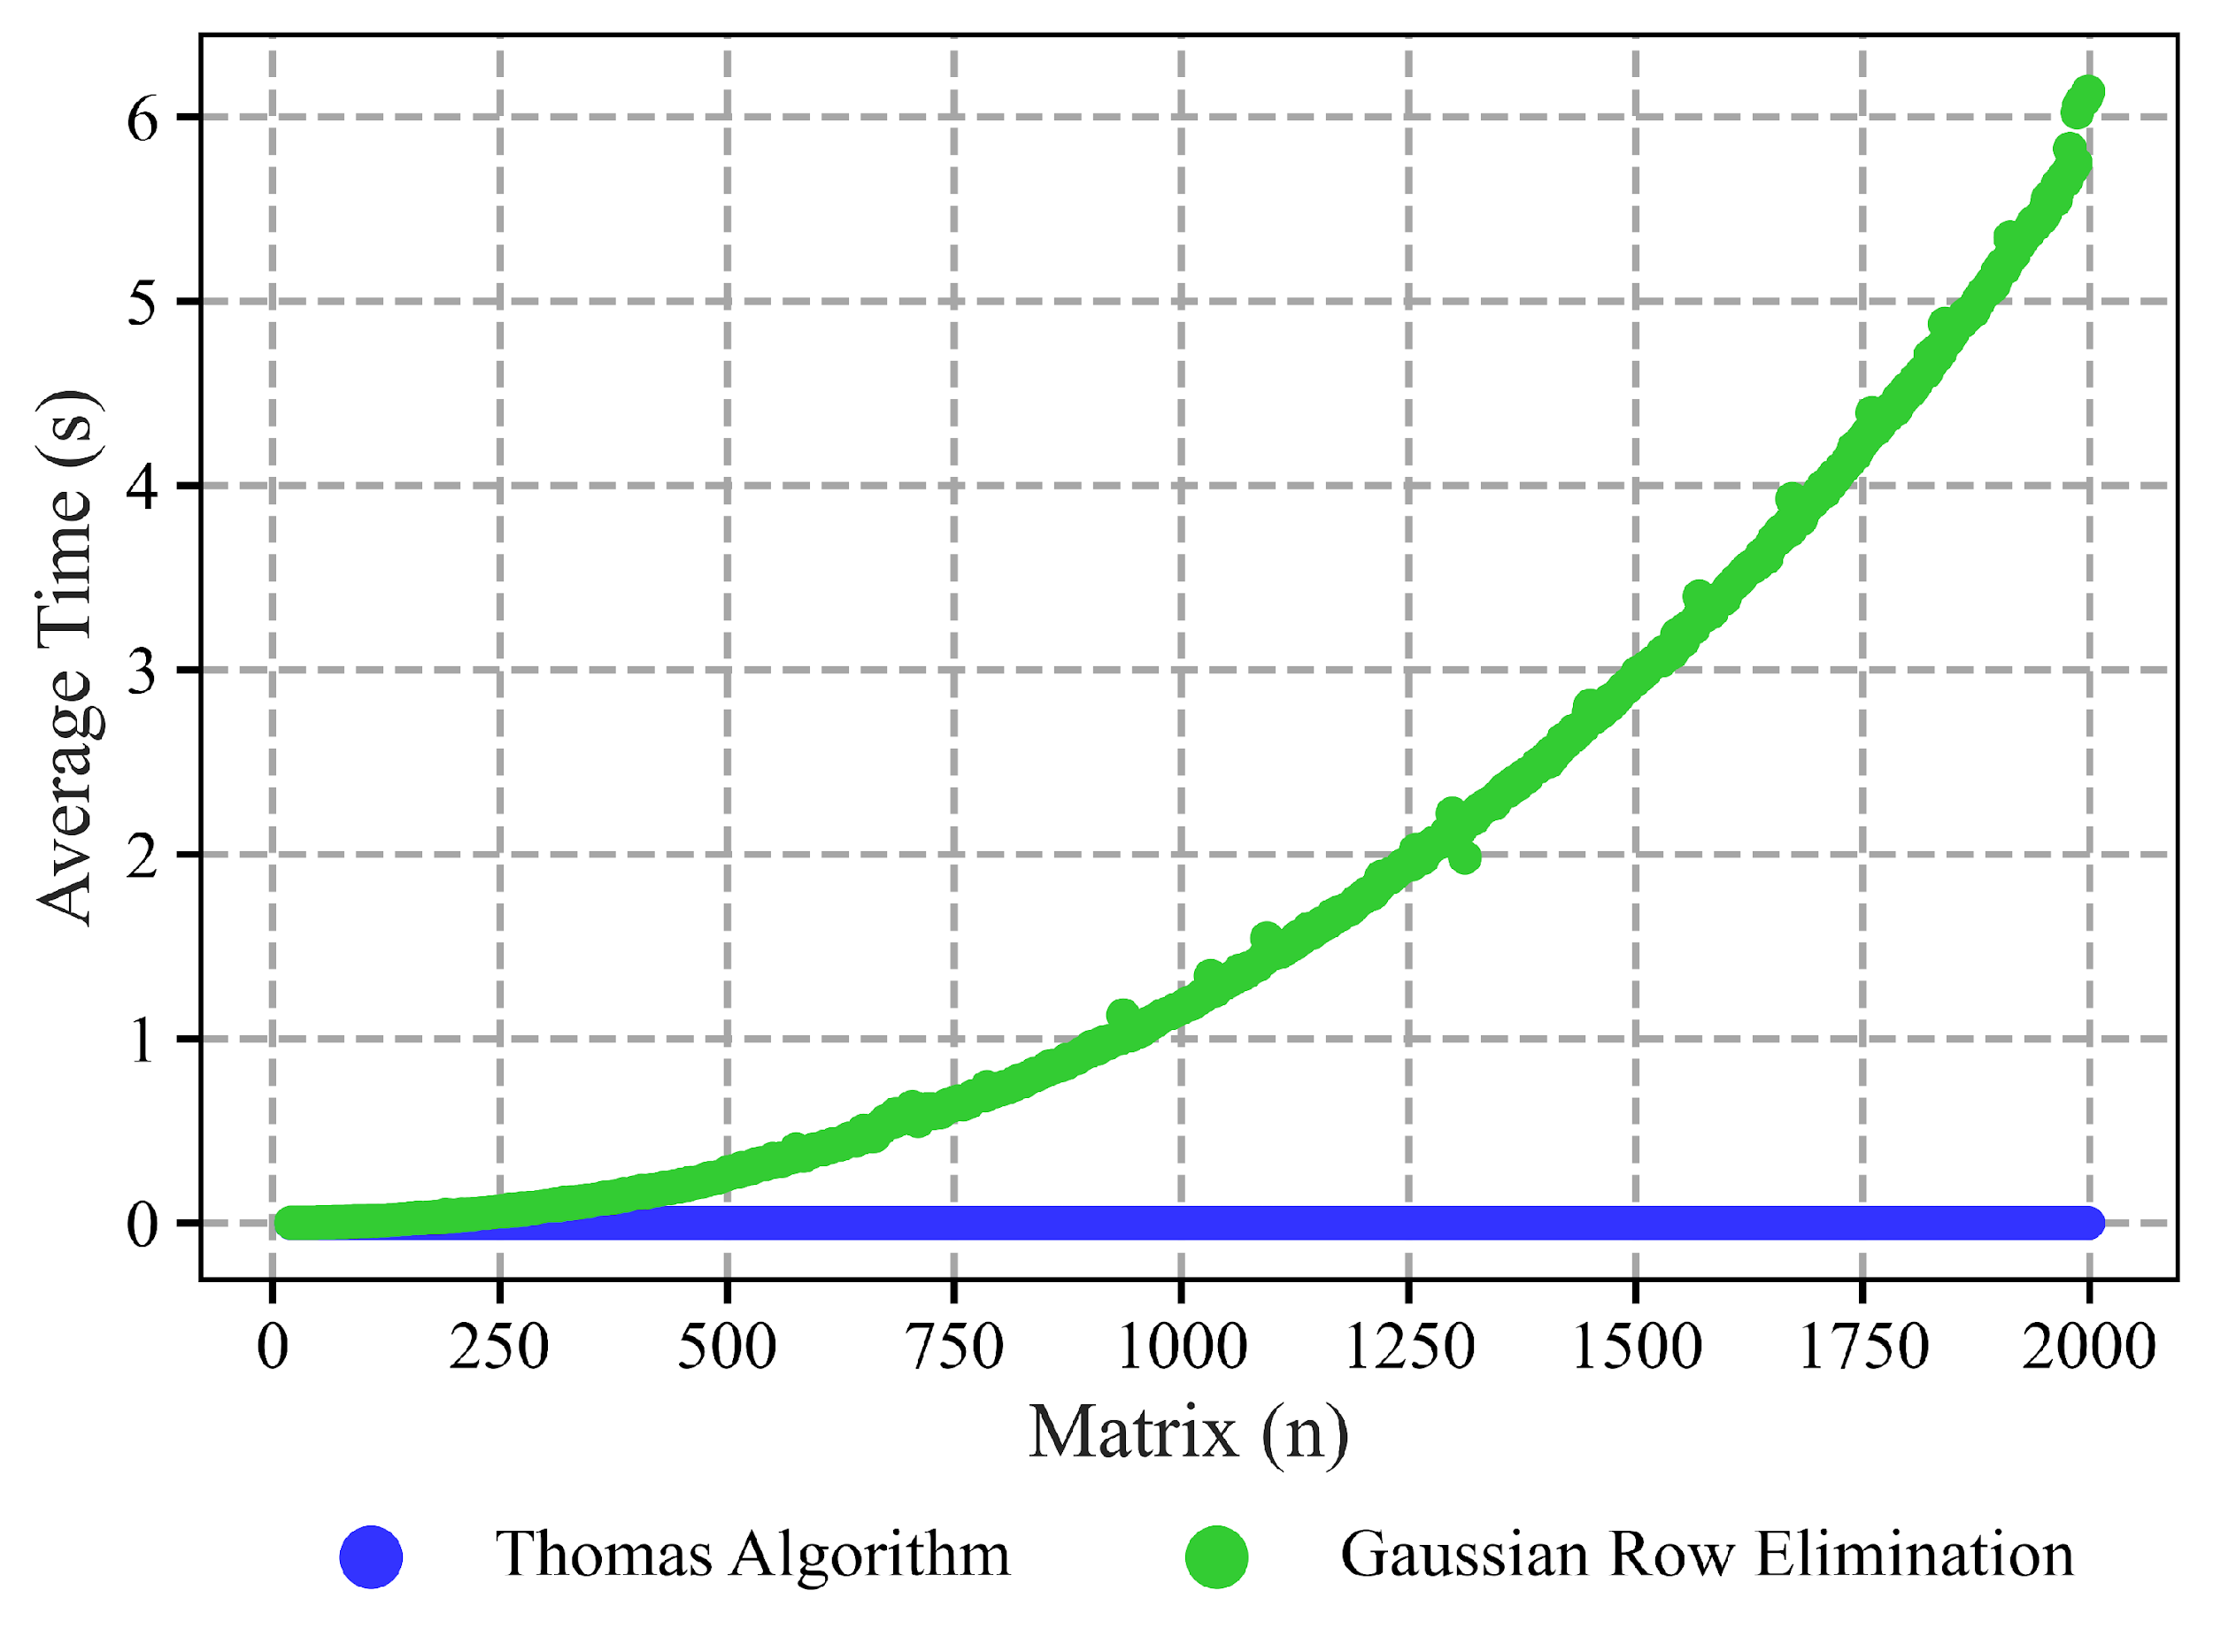
Time Comparison

Slide 17
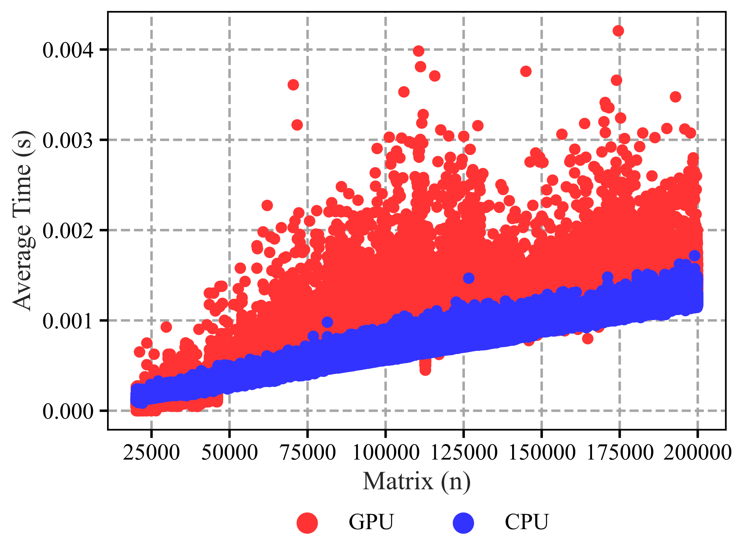
CPU vs GPU

Slide 18

Conclusion
The Thomas Algorithm offers significant speed ups
For this case we can have additional speed ups on $α, β$
Garlerkin Method does not guarantee a tridiagonal matrix
The Thomas Algorithm is only valid for tridiagonal matrices

Slide 19
Referances
[1] A. Povitsky. Efficient parallel-by-line methods in cfd. In D. KEYES, A. ECER, J. PERIAUX, N. SATOFUKA, and P. FOX, editors, Parallel Computational Fluid Dynamics 1999, pages 337– 343. North-Holland, Amsterdam, 2000.
[2] Bastian E. Rapp. Chapter 32 - finite element method. In Bastian E. Rapp, editor, Microfluidics: Modelling, Mechanics and Mathematics, Micro and Nano Technologies, pages 655–678. Elsevier, Oxford, 2017.
[3] C.S. Yu and J. Berlamont. Modelling tidal flows in the northwest european continental shelf seas on parallel computers. In C.A. Lin, A. Ecer, J. Periaux, N. Satofuka, and P. Fox, editors, Parallel Computational Fluid Dynamics 1998, pages 525–532. North-Holland, Amsterdam, 1999.
[4] Yao Zhang, Jonathan Cohen, Andrew A. Davidson, and John D. Owens. Chapter 11 - a hybrid method for solving tridiagonal systems on the gpu. In Wen mei W. Hwu, editor, GPU Computing Gems Jade Edition, Applications of GPU Computing Series, pages 117–132. Morgan Kaufmann, Boston, 2012.

Slide 20

Links
https://aaronschwan.github.io/APPM4600FinalProjectSparseSolvers/

Slide 21
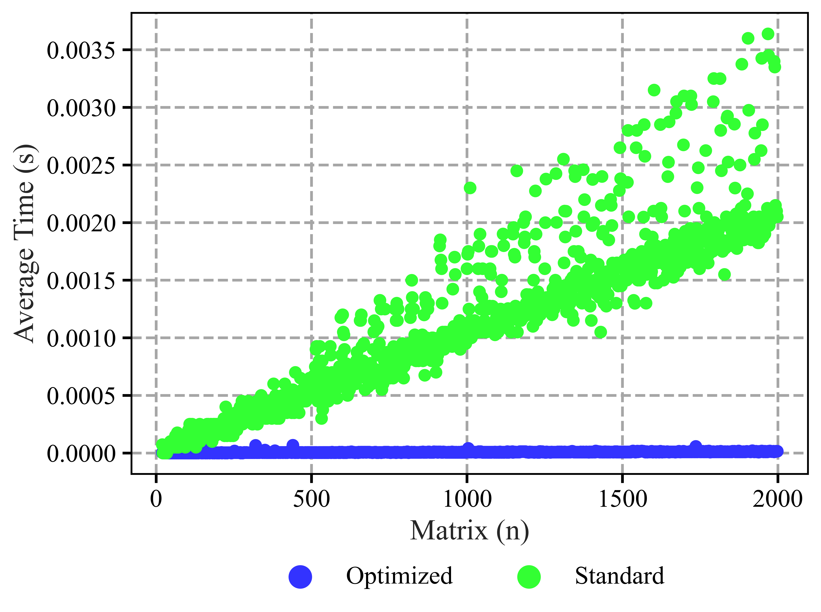
Standard vs Optimized Thomas Algorithm

